Slide 1
The supplier register — how to run one request
From "someone wants a new tool" to a decision you could show an auditor. Twelve steps, in order.
ISMS-REG-20 · Supplier and third-party risk register · v1.0 · sameerkhairkar.com
sameerkhairkar.com · ISMS-REG-20 v1.0

Slide 2
The order — it cannot be shuffled
Each step feeds the next. Skipping one does not save time; it moves the work to the audit.
01
Fill in the request — who is asking, and what for
07
See what the tier requires of you
02
Answer the data question honestly
08
Clear every stop signal
03
Identify the legal entity behind the product
09
A sanctions hit stops everything
04
Run the screening and record it
10
Decide, and record the conditions
05
Look the company up on the official lists
11
Hand the request over into the Register
06
Read the result — the sheet does the scoring
12
Send the questionnaire the tier calls for
sameerkhairkar.com · ISMS-REG-20 v1.0

Slide 3
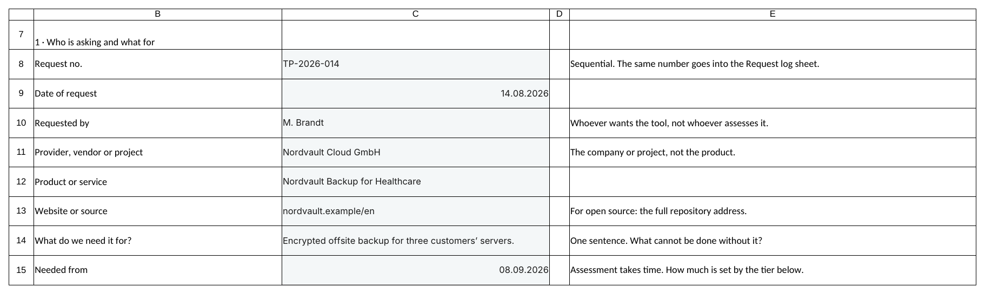
Step 1 · Fill in the request
Request sheet, section 1. Tinted cells only — everything else computes itself.
One request per third party. A second tool means a second request.
You do not need to know the standard. If you cannot answer with confidence, pick the less favourable option.
The provider is the company. The product is what you buy from them. They are not the same field.
screenshot: worked example TP-2026-014 · a fictional cloud backup provider
sameerkhairkar.com · ISMS-REG-20 v1.0

Slide 4
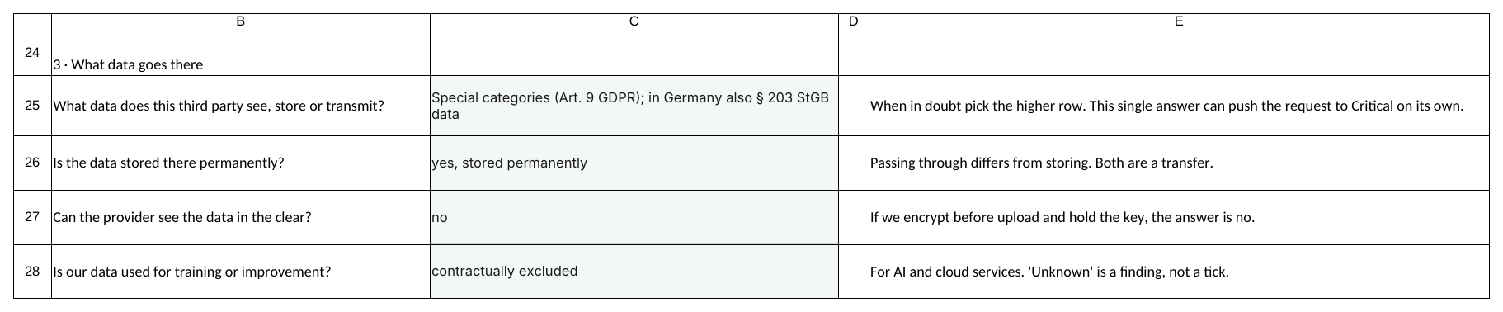
Step 2 · Answer the data question honestly
Section 3. This is the single most consequential answer in the form.
"Special categories (Art. 9 GDPR)" scores 3 and pushes the request to Critical on its own.
"Passing through" and "storing" are both transfers. Answer for what actually happens.
"Unknown" about training use is a finding with a deadline, not a tick.
When in doubt, pick the higher row. Over-classifying costs you a questionnaire; under-classifying costs you the audit.
screenshot: worked example TP-2026-014 · a fictional cloud backup provider
sameerkhairkar.com · ISMS-REG-20 v1.0

Slide 5
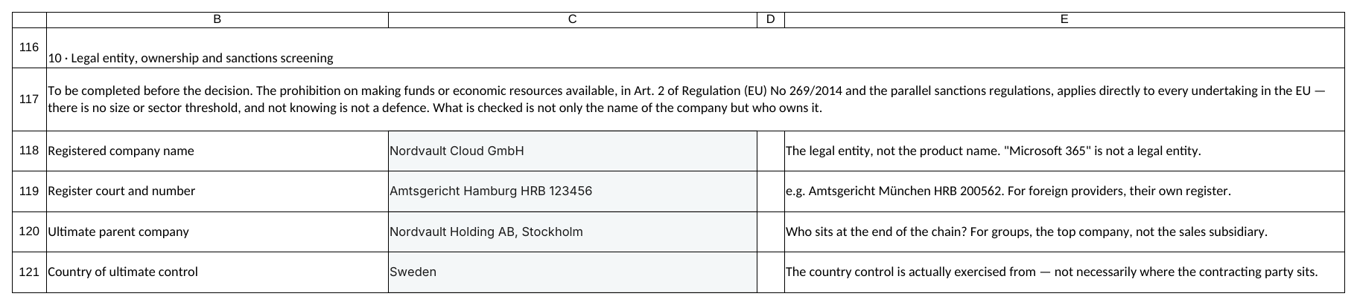
Step 3 · Identify the legal entity
Section 10, first half. New in v0.4 — you cannot screen what you have not named.
Name the legal entity, not the product. "Microsoft 365" is not a company.
Register court and number pin it down. For a foreign provider, use their own register.
The ultimate parent and the country of ultimate control matter as much as the name — a clean German GmbH can still be controlled from elsewhere.
screenshot: worked example TP-2026-014 · a fictional cloud backup provider
sameerkhairkar.com · ISMS-REG-20 v1.0

Slide 6
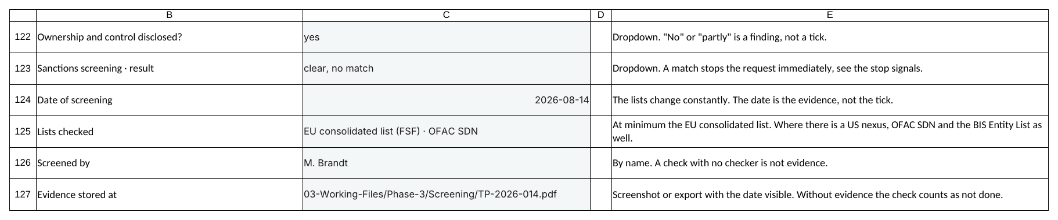
Step 4 · Run the screening and record it
Section 10, second half. Six fields, and every one of them is evidence.
Ownership disclosed? "No" or "partly" is a finding, not a tick.
The date matters more than the result — the lists change constantly, so a check without a date proves nothing.
Name the person who checked, and store the screenshot. A check with no checker is not evidence.
screenshot: worked example TP-2026-014 · a fictional cloud backup provider
sameerkhairkar.com · ISMS-REG-20 v1.0

Slide 7
Step 5 · Look the company up
Free, official, no registration. Takes about two minutes per vendor.
EU consolidated list of financial sanctions
The binding one. Start and finish here.
webgate.ec.europa.eu/fsd/fsf
EU Sanctions Map
Which regime applies to which country.
sanctionsmap.eu
EU Sanctions Helpdesk
Free personalised help, built for SMEs. Use it.
eu-sanctions-compliance-helpdesk.europa.eu
OFAC Sanctions List Search
Where there is a US nexus — most large software and hardware vendors.
sanctionssearch.ofac.treas.gov
US Consolidated Screening List
Several US agency lists in one search.
trade.gov/consolidated-screening-list
Search three things, never one: the company, the ultimate parent, and the controlling persons. A company that is not itself listed is still caught where a listed person holds more than 50 % or otherwise controls it.
sameerkhairkar.com · ISMS-REG-20 v1.0

Slide 8
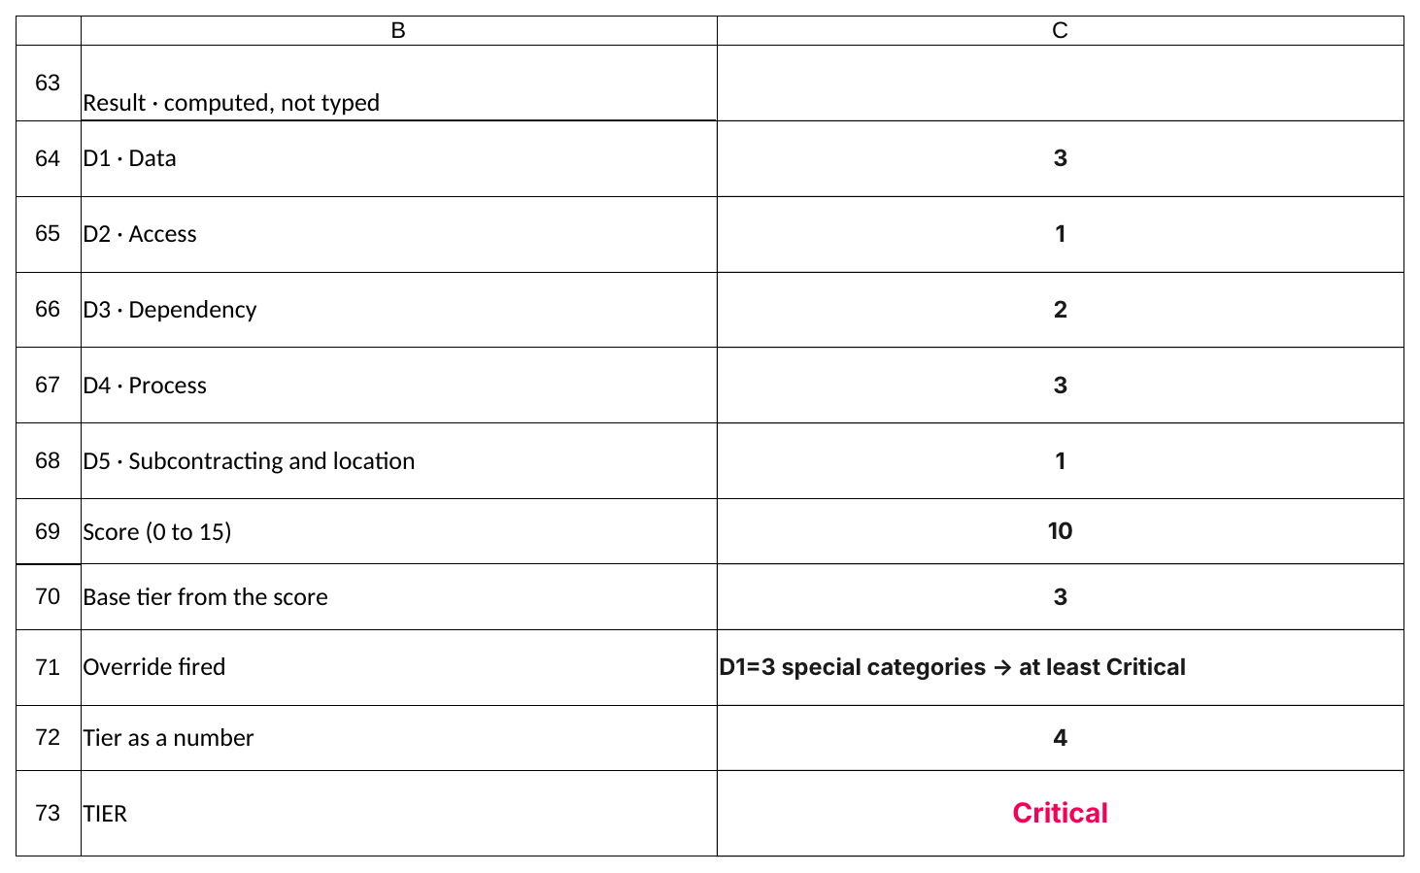
Step 6 · Read the result
The sheet scores the five axes, applies the overrides, and names the tier. Nobody types this.
Five axes, 0–3 points each. Score 10 here.
The score alone said High. The override — special categories — lifted it to Critical.
Overrides only ever raise a tier. They never lower one.
screenshot: worked example TP-2026-014 · a fictional cloud backup provider
sameerkhairkar.com · ISMS-REG-20 v1.0

Slide 9
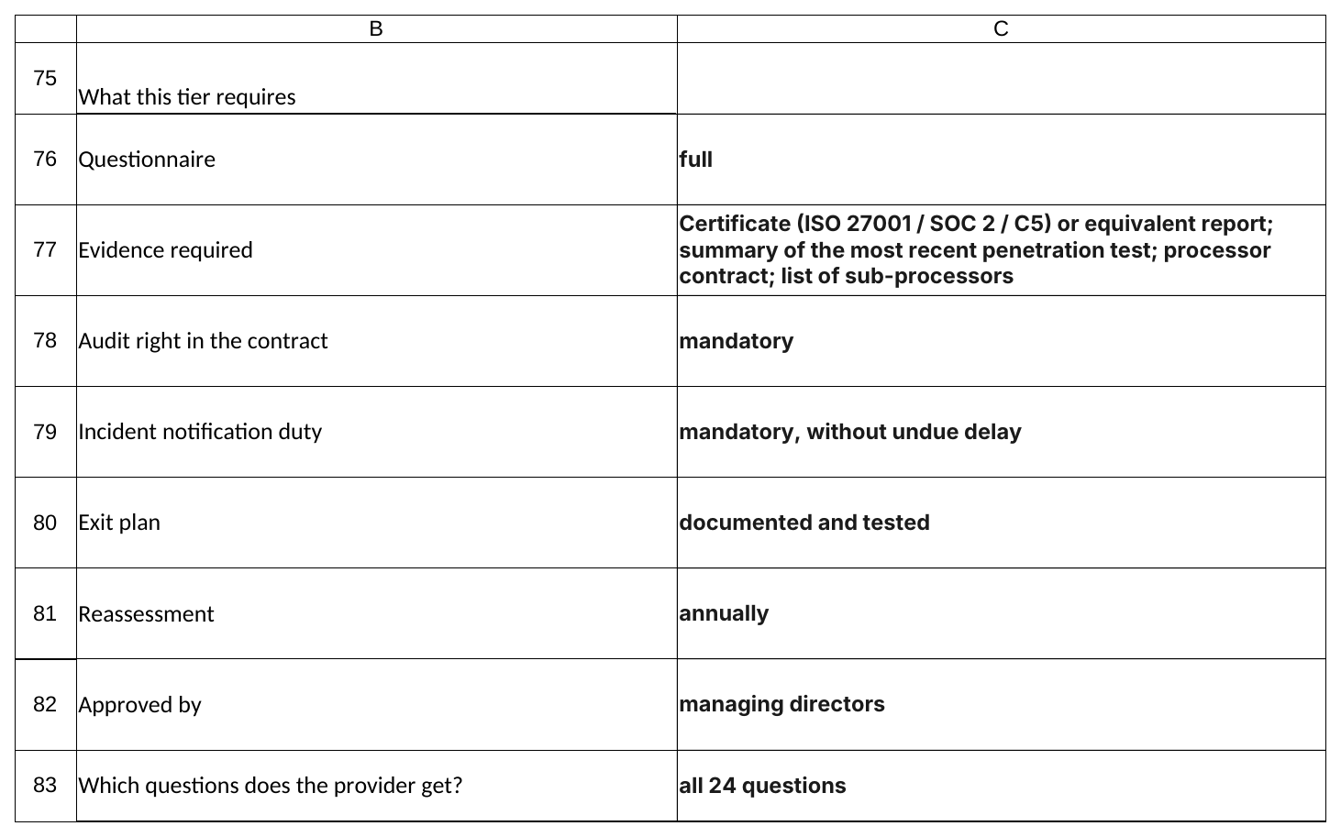
Step 7 · See what the tier requires
The tier is not a label. It decides the questionnaire, the evidence, the contract terms and the review cycle.
Critical: full questionnaire, certificate or equivalent report, penetration test summary, processor contract, sub-processor list.
Audit right and immediate incident notification become mandatory, not negotiable.
The exit plan must be documented and tested, and reassessment is annual.
screenshot: worked example TP-2026-014 · a fictional cloud backup provider
sameerkhairkar.com · ISMS-REG-20 v1.0

Slide 10
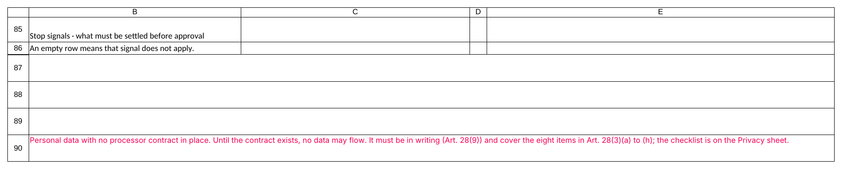
Step 8 · Clear every stop signal
An empty row means the signal does not apply. A filled row means something must be settled first.
Here: personal data with no processor contract in place. Until it exists, no data flows.
Every signal names its legal basis, so you can put it in an email without looking anything up.
A signal is not advice. It is a gate.
screenshot: worked example TP-2026-014 · a fictional cloud backup provider
sameerkhairkar.com · ISMS-REG-20 v1.0

Slide 11
Step 9 · A sanctions hit stops everything
This is the one signal with no workaround and no proportionality argument.
Nothing is approved. Nothing flows. It goes to the managing directors the same day.
The prohibition binds every EU company directly — no size threshold, no sector limit.
"We did not know" is not a defence, which is why the screening is mandatory before approval.
screenshot: worked example TP-2026-014 · a fictional cloud backup provider
sameerkhairkar.com · ISMS-REG-20 v1.0

Slide 12
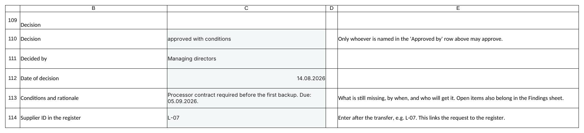
Step 10 · Decide, and record the conditions
Only whoever the tier names may approve. For Critical and High that is the managing directors.
"Approved with conditions" is a real answer — say what is missing, by when, and who fetches it.
Every condition also becomes a row on the Findings sheet. Otherwise it is a promise, not a control.
Refusals stay in the Request log. They are the evidence that selection criteria were applied.
screenshot: worked example TP-2026-014 · a fictional cloud backup provider
sameerkhairkar.com · ISMS-REG-20 v1.0

Slide 13
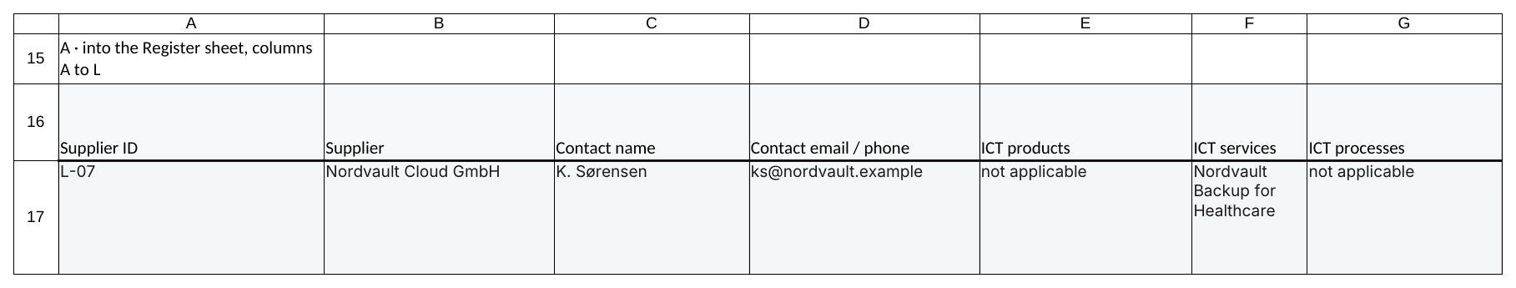
Step 11 · Hand it over into the Register
The Handover sheet lays the request out in exactly the column order the Register expects.
Copy as values. Pasting formulas overwrites the computed columns.
Assign the supplier ID yourself — it is the key every other sheet joins on.
Write the ID back into the request so the two can be traced to each other.
Without a complete Register the CIR No. 5.2 duty is not met — and that duty applies to every supplier, including tier Low.
screenshot: worked example TP-2026-014 · a fictional cloud backup provider
sameerkhairkar.com · ISMS-REG-20 v1.0

Slide 14
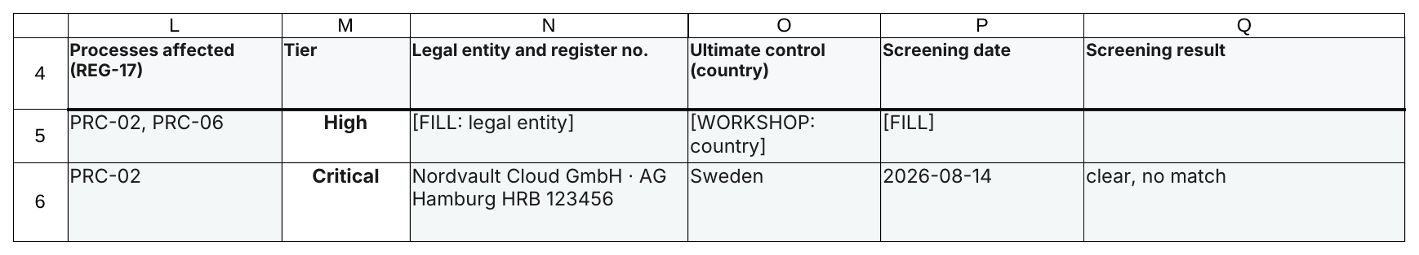
The Register keeps the evidence
The last columns are what make the screening auditable months later.
Legal entity and register number, country of ultimate control, screening date and result.
The date matters more than the tick: the lists change constantly.
Re-screening rides on the existing reassessment cycle — no separate calendar.
screenshot: worked example TP-2026-014 · a fictional cloud backup provider
sameerkhairkar.com · ISMS-REG-20 v1.0

Slide 15
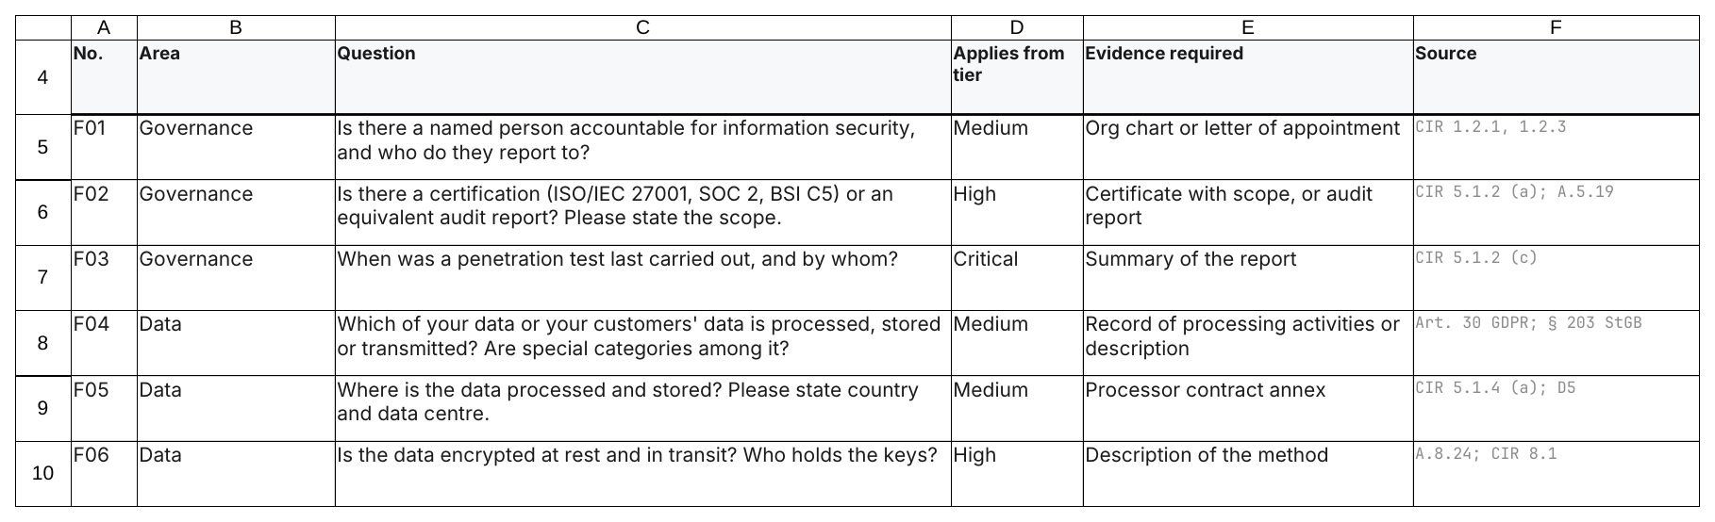
Step 12 · Send the questionnaire
The "applies from tier" column decides who gets which question. It is cumulative.
Tier Low gets no questionnaire — only the Register entry.
Every question names its source, so the supplier can see it is not invented.
"We do not have that" is a valid answer. It becomes a finding, not an argument.
screenshot: worked example TP-2026-014 · a fictional cloud backup provider
sameerkhairkar.com · ISMS-REG-20 v1.0

Slide 16
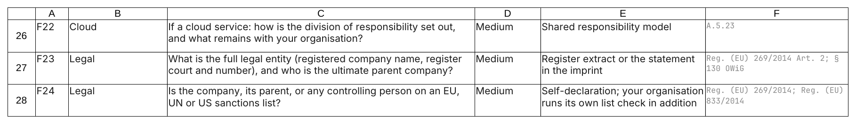
Two questions people forget to ask
F23 and F24 — new in v0.4, and the reason the screening is not just a self-declaration.
F23 asks for the legal entity and the group structure.
F24 asks the supplier to declare its own sanctions status.
The declaration supplements your own check. It never replaces it.
screenshot: worked example TP-2026-014 · a fictional cloud backup provider
sameerkhairkar.com · ISMS-REG-20 v1.0

Slide 17
If you remember three things
1
Fill the tinted cells, nothing else
The scoring, the tier, the questionnaire and the stop signals all compute themselves. Overwrite a bold centred cell and the row starts lying to you.
2
A stop signal is a gate, not a note
Approve past one and the workbook stops being evidence. Clear it, or record the condition and the deadline.
3
Screen the owner, not just the name
The company, the ultimate parent, the controlling persons. Two minutes, once per vendor, at onboarding and at each review.
Not legal advice · adapt the document IDs to your own numbering · have the sanctions position confirmed by counsel
sameerkhairkar.com · ISMS-REG-20 v1.0

